Slide 1
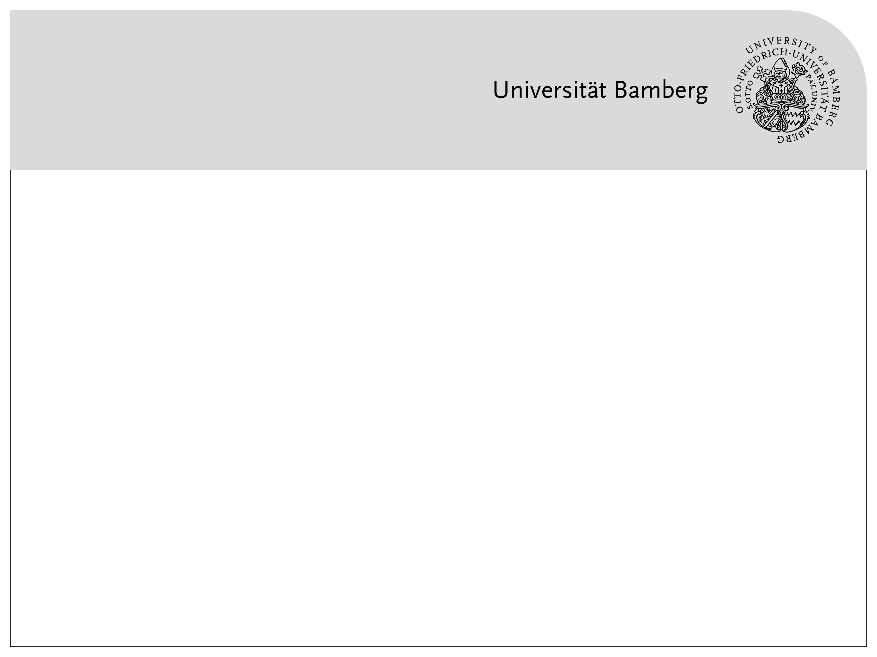
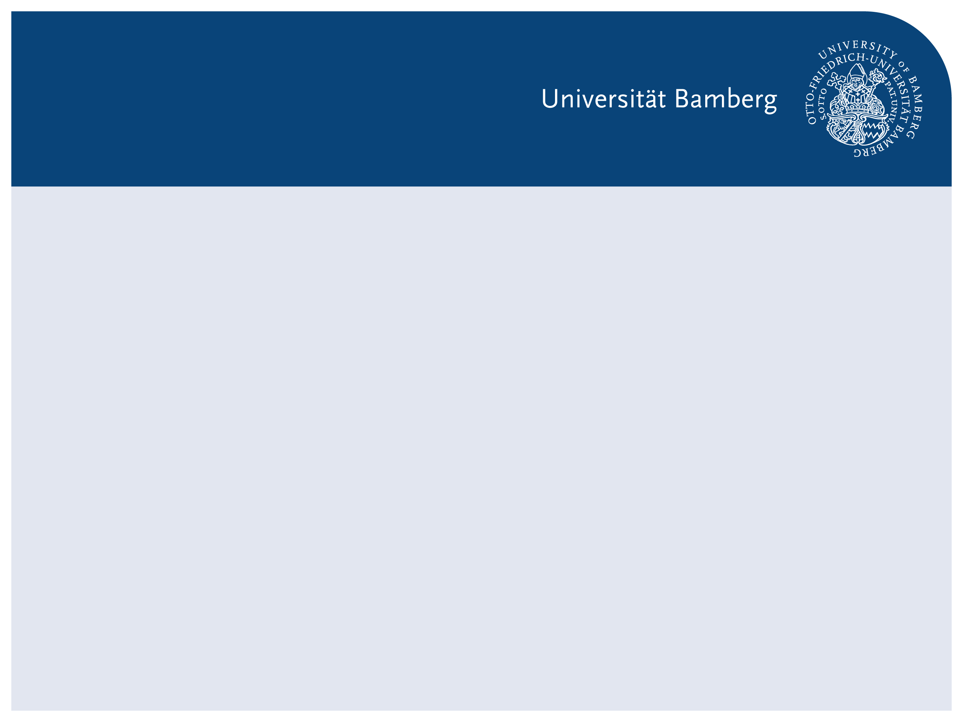
From Accuracy to Explainability: Understanding CNN Errors with xAI
xAI-Proj-B Course Project – CNN-based Image Classification

Slide 2
Course Context & Motivation
Context
Explainable AI course
All teams: first CNN + xAI project
Motivation
CNN accuracy can look convincing
But:
Are errors random?
Can we trust confident predictions?

Slide 3
CNN Basics (Learner Perspective)
CNN Intuition
CNNs learn hierarchical visual features
Early layers: edges, textures
Deeper layers: shapes, object parts
Why CNNs
Designed for image data
Widely used in object classification

Slide 4
Model Choice & Baselines
Our Setup
Backbone: ResNet18
10-class image classification
Baseline Design
Different pretraining sources
Different training strategies

Slide 5
Research Question & Red Thread
Research Question
What kinds of errors does a CNN make?
How confident is it when it is wrong?
Can xAI help us understand these errors?
Red Thread
Build → Observe → Question → Explain

Slide 6
Unlocking Transfer Learning: A Comparative Analysis of Baseline Models
Four Baselines (A–D): Pretraining × Training Strategy
Task: 10-class household object classification (ResNet-18 backbone)
Factor 1 (Pretraining): ImageNet vs. Flowers
Factor 2 (Training): Frozen backbone (linear probing) vs. full fine-tuning
 | Frozen backbone | Fine-tuning
ImageNet | Model A | Model B
Flowers | Model C | Model D

Slide 7
Model A & B: ImageNet Pretraining - Linear Probing vs. Fine-Tuning
Model A (Linear Probing)
Trainable: classifier only (backbone frozen)
Val Acc: 6.25% (add chance note correctly)
Takeaway: fixed ImageNet features do not transfer well → adaptation needed
Model B (Fine-Tuning)
Trainable: all layers (backbone unfrozen)
Val Acc: XX% (or “preliminary / pending”)
Takeaway: fine-tuning adapts features, but sensitive to LR / overfitting

Slide 8
Model C & D: Flowers Pretraining - Linear Probing vs. Fine-Tuning
Model C (Linear Probing)
Trainable: classifier only (Flowers backbone frozen)
Takeaway: tests whether Flowers’ features transfer without adaptation
Model D (Fine-Tuning)
Trainable: all layers (Flowers backbone unfrozen)
Takeaway: combines domain-specific pretraining + adaptation (often strongest, but higher compute)

Slide 9
Cross-Model Comparison: Insights from the 2×2 Design
Effect of fine-tuning: compare A→B and C→D (adaptation vs. frozen features).
Effect of pretraining source: compare A→C and B→D (ImageNet vs. Flowers).
Trade-off: fine-tuning improves adaptability, but increases compute and overfitting risk.
Design benefit: the 2×2 setup isolates pretraining and training strategy effects.

Slide 10
Conclusion: Methodological Strength and Next Steps
What we learned: Frozen backbones can fail on our task;
fine-tuning is typically needed for domain adaptation.
Why the design matters: The 2×2 setup isolates two factors—
pretraining source and training strategy—so comparisons are interpretable.
Next steps: Use the strongest baseline as the reference model for
error analysis and explainability (e.g., saliency / CAM), and evaluate robustness across conditions.

